Slide 1

New Officials Orientation
Virginia Swimming

Slide 2
Welcome to the Officials Team
What you should learn from this clinic
* The governing bodies
* The training process to become a certified USA-S Official
* Where to find reference info
* The action items you will need to complete
* Who the Officials are on deck

Slide 3
Why become a USA-S Official?
Where we get our rules?
Who and what is VSI?
What is the officials committee?
Where to find information?
Joining USA Swimming
Background Check
Athlete Protection Course
Training
Signing up for Meets
Mentoring during Meets
Officials on the Deck
OUTLINE FOR THE ORIENTATION

Slide 4






Why Become an Official?
“Desire to do more than just the minimum”
“Too hot in the stands”
“It was a way to become involved in my kid’s sport”
“My club needs officials to host meets”
“Someone twisted my arm”
“Just love swimming and I wanted to be involved”
“Looking for a new challenge and want to learn the rules”
“Timing is boring”

Slide 5
Chief Timer
The Need for Officials
Position | Local Meets | Large Meet
Meet Referee | 1 | 1
Adminstrative Ref | 0-1 | 3
Deck Referee | 1 | 4
Starter | 1 | 4
Chief Judge | 1 | 6
Stroke & Turn | 6-12 | 30
Administrative Official | 1 | 2
Timing Equipment Operator | 1 | 2
Recorder | 1 | 3
Chief Timer* | 1 | 1
Timers* | 16-20 | 16-20
Marshalls* | 3-4 | 5+
Meet Director* | 1 | 4
Announcer* | 1 | 1
Total | 36-47 | 91+

Slide 6
CERTIFIED OFFICIALS ON DECK
Meet Referee
Administrative Referee/Official
Deck Referee
Recorder/
Hy-Tek Operator
Timing System Operator(CTS,DTS)
Starter
Chief Judge
Stroke and Turn Judge
DRY DECK
WET DECK

Slide 7
What Makes a Good Official
* Punctual
* Willing to listen, learn, be flexible
* Good judgement – Fair and impartial
* Professional
* Upbeat attitude
* Always has the best interest for the swimmers

Slide 8
Where do we get our Rules?
Who uses What?
FINA
USA SWIMMING
YMCA
USA-S Rules
NCAA
NFHS
Summer
Recreational
Leagues
Documents
USA Rulebook
VSI Officials Handbook
VSI Swim Officials Standards of Conduct
Website-(USA-S, Va)

Slide 9
Who and What is VSI?
● One of 59 local swim committee’s of USA-S
● Governing body for Virginia and parts of North Carolina
● Membership made up of seasonal clubs, year-round clubs and affiliated group members
● Oversees swimming programs that consistent with USA-S best practices
● Board of Directors elected by the House of Delegates who guide the membership

Slide 10
VIRGINIA OFFICIALS COMMITTEE
VSI Officials Chair- The Officials Committee is a standing committee of VSI and is responsible for the testing, certification, evaluation and supervision of all officials. The Chairperson of this Committee is responsible for seeing that these functions are fulfilled by the Committee.
District Chair- VSI is divided into 4 districts and these same districts are used by the Officials Committee to oversee training.
Club Official Chair- Sets up training clinics for new officials and assists training officials with scheduled training sessions at meets. Organizes officials for both home and away meets. Teams first point of contact.
Virginia Officials Chair
4-District Official Chairs
Non-Voting Members
Team Chairs

Slide 11
Where to find information?
□ Two main websites
1. www.usaswimming.org
2. www.virginiaswimming.com
USA Swimming has everything you want to know about swimming – nutrition, featured articles, rules, etc.
* Under For You, click on Officials for USA-S
registration, background check, athlete protection
training and test
□ Virginia Swimming site:
* Officials handbook, standards of conduct, newsletters, training, reference documents

Slide 12
Joining USA Swimming
Step 1. Set up an account at USASwimming.org
  Step 2. Establish a User Name and password
  Step 3. Apply as a non-athlete member OR as an Apprentice Official. The later is valid for only 60 days
  Step 4. At USA Swimming
○ Applicable test – link to your USA Swimming Account
  ○ Level II background check – link to your USA Swimming Account
  ○ Athlete protection training – link to your USA Swimming Account
  Step 5. At CDC or NFHS, complete concussion training
○https://www.cdc.gov/headsup/youthsports/training/index.html
  ○ https://nfhslearn.com/courses/61151/concussion-in-sports
  ○ Send Course Completion certificate to registration businessoffice@virginiaswimming.org or vaswimreg@gmail.com

Slide 13
Background Check
USA Swimming:
https://www.usaswimming.org/for-you/officials
Scroll down to Officials Quick Links
Request LEVEL II Background check –
Regardless of any current security clearance
Good for two years
Initial Cost is $38.00
Renew every two years at $18.00
Must be completed PRIOR TO FINAL 3 TRAINING WALKS

Slide 14
Athlete Protection Training
USA Swimming:
https://www.usaswimming.org/for-you/officials
Scroll down to Officials Quick Links
Three (3) courses designed to educate and create awareness to protect our Athletes
Takes about 1 hour to complete
Cost is $0
Short reflective quiz at the end
Renewal is every 1 year

Slide 15
USA Swimming Tests
USA Swimming:
https://www.usaswimming.org/for-you/officials
Scroll down and click on Officials Online Testing
Stroke and Turn: Select Certification - Stroke & Turn/Timer
Timing Equipment Operator: Select Certification - Timer
Administrative Official: Two tests required
Select Certification – Administrative Official and Timing Judge
Results emailed in less then a day
Cost is $0

Slide 16
Concussion Protocol Training
USA Swimming:
https://www.usaswimming.org/for-you/officials
Scroll down to Officials Quick Links
Select either the CDC or NFHS Course
When completed, save the certificate of training and send it to
businessoffice@virginiaswimming.org or vaswimreg@gmail.com
Best to send it after you are a USA Swimming Non-Athlete Member
Mary or Emily will your Deck Pass noting your completion.
Cost is $0

Slide 17
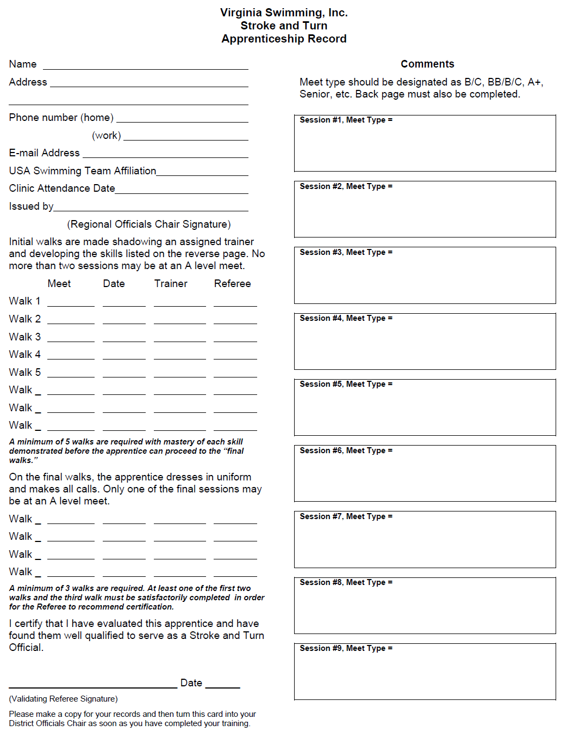
TRAINING
Take Training Card to each session
    Must be signed by Trainer and Referee
  Once Training is completed, send a copy of the Apprentice Record to your District Chair
  Southeast- Genny Kimbel
    gennykimbel@gmail.com
  Central- Bob Rustin
    brustin55@gmail.com
  North- Michael Sizemore
    mcsizemore@gmail.com
  Southwest- Beth Arnold (N) or George Zolovock (S)
  arnoldeaa@gmail.com OR gzolovick@gmail.com
    AND
  Officials Tracking System-George Fuhs
    hgfuhs@verizon.net

Slide 18
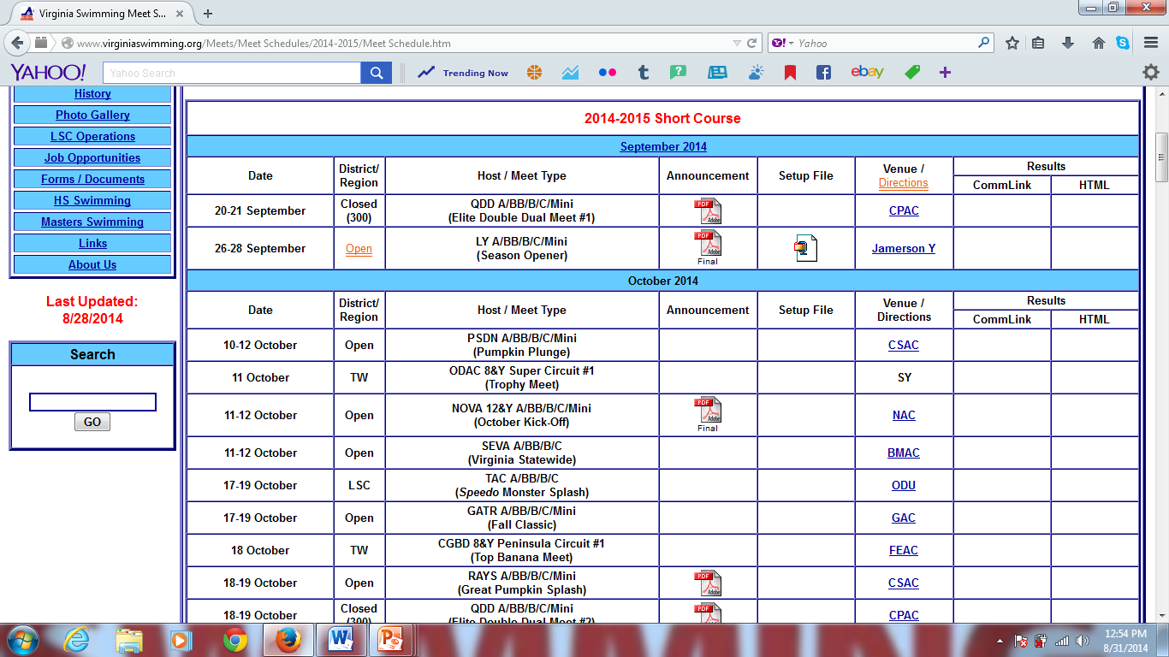
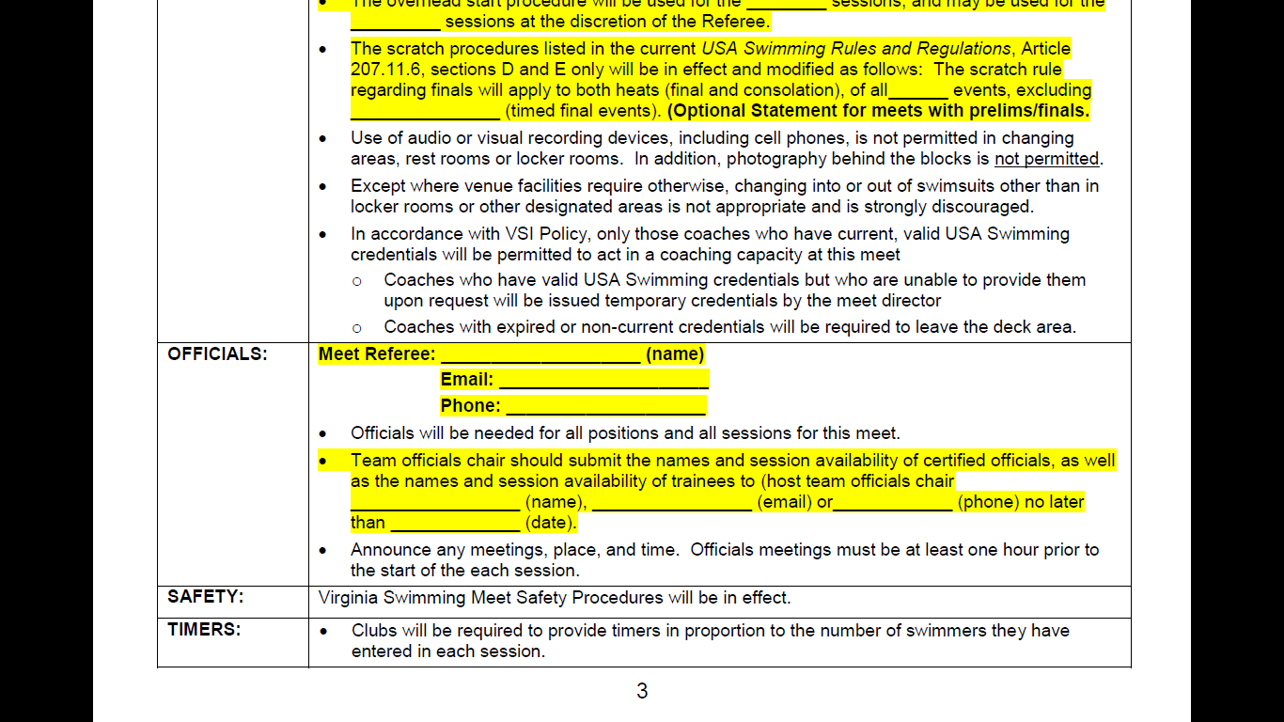
SIGNING UP TO TRAIN AT A MEET
All training sessions must be performed at VSI/USA sanctioned meets. Approval for non-VSI/USA meets or meets outside the LSC requires prior approval of the apprentices District Chair, or the LSC Officials Chair.
To sign up for a meet contact your team’s Official Chair.
May also contact the Official Coordinator for the meet attending and sign up. Let your team Chair know.
Training is on a first come first serve basis and may be limited due to numbers or length of session

Slide 19
Mentoring Sessions
Must work three sessions with a certified official
 No more than 2 sessions per meet
 Please do not wear blues and whites, refrain from wearing team shirts
 Allowed two sessions at a Masters Meet
Majority of sessions should be with BB/B/C swimmers
 Age 14 & U best learning opportunity
 Learn from the good and not so good
Will be assigned at mentor at pre-session briefing
Best advice – ASK QUESTIONS
Learn the language of the rules

Slide 20
Final Sessions
What must be completed before you work your final sessions?
HINT: 5 items
1. Registered as a non-athlete with USA Swimming
2. Pass your applicable test
3. Complete the Level II Background check
4. Complete the Athlete Protection Training
5. Complete the Concussion Training
Mentor is looking for:
Promptness
Knowledge of rules and ability to explain them
Comfortable on deck
Dress – White Shirt, Blue shorts/slacks/skirt and white shoes
Work 3 sessions with positive ratings from your mentor
May not work finals or LSC Championship meets until certified

Slide 21
Keep your Club chair updated with your training progress
If you sign up – show up on time, work the entire session
All training shall be performed at VSI/USAS sanction meets
Learn the rules applicable to your position
Must have approval to train at non-VSI LSC meets (outside of VA LSC)
High School, NCAA and non-VSI sanctioned meets are not acceptable
Can train at Non-VSI sponsored championship-format meets (prelims/finals) for prelims only
Cannot train at VSI sponsored championship meets unless approved by VSI Officials Chair and District Chair.
Trainee’s Responsibilities

Slide 22
Once completed with training:
* Send copy of training card to your district chair
* You will receive email from webmaster@USASwimming.org
* Print out your certification card, carry it with you to all meets.
* Will receive a white shirt, name tag, badge and pouch
* Maintain current technical and philosophical understanding of the rules
* Work at least the minimal # of sessions per year
* Fulfill any education requirements
* Maintain current registration, background check and athlete protection training
* Advancement opportunities
Trainee’s Responsibilities

Slide 23
1. Have fun
Final Words
2. Ask a lot of questions
3. Always try to learn something new about swimming at every meet
4. & Most of all
Thank you for volunteering and all you do for our sport!
See you on deck soon!

